Slide 1

Fire Detection Using Image Processing
1
CSE 4128 : Image Processing and Computer Vision Laboratory
Presented To:
Dr. SK. Md. Masudul Ahsan
Professor Department of Computer Science & Engineering Khulna University of Engineering & Technology Dipannita Biswas
Lecturer Department of Computer Science & Engineering Khulna University of Engineering & Technology
Presented By:
Md. Masudur Rahman Rabby
Roll: 1907113 Department of Computer Science & Engineering Khulna University of Engineering & Technology

Slide 2
Table of contents
01
05
02
06
03
07
04
08
2
Introduction
Methodology
Project Focus
Result and Output
Application Features
Limitations
Key Steps
Conclusions

Slide 3
01
Introduction
3

Slide 4
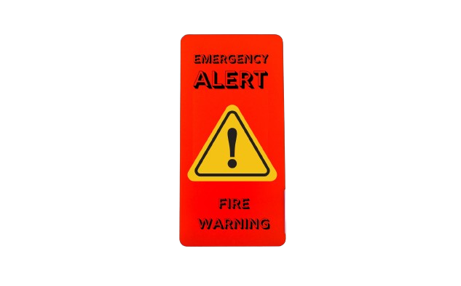
Introduction
4
Fire detection: The process of identifying the presence of fire through sensors or computer vision techniques.
Methods: Using image processing, computer vision techniques or combined technologies.
Detection Techniques: Includes infrared sensors, thermal imaging cameras, and computer vision algorithms that analyze patterns and changes indicative of fire.
Algorithm Implementation: Implement algorithm like edge detection, thresholding, and region segmentation to isolate and identify potential fire regions in digital images or video frames.
Detection Techniques:
- Traditional
- Digital Image Processing
- Computer Vision
Techniques
Algorithm Implementation:
- Edge Detection
- Thresholding
- Region Segmentation
Fire Detection

Slide 5
02
Project Focus
5

Slide 6
Project Focus
6
Develop a fire detection algorithm using basic image processing techniques.
Developing a GUI for user comfort of the application.
Avoid reliance on machine learning models which require extensive training data and computational resources.

Slide 7
03
Application Features
7

Slide 8
Application Features
8
User-friendly GUI built with Tkinter.
Allows easy image loading and processing.
Sequential display of image processing steps for transparency and educational purposes.

Slide 9
04
Key Steps
9

Slide 10
Key steps
10
Load Image: Allows selection and loading of an image.
Clear Panels: Resets GUI for new image results.
Display Functions: Shows images and results on GUI frames.
Detect Fire: Key steps include:
Convert to HSV for color-based analysis.
Apply threshold to identify fire regions.
Use morphological operations to refine results.
Find and draw bounding boxes around detected fires.

Slide 11
05
Methodology
11

Slide 12
Methodology
12
Load Image
Thresholding
(Binary Mask)
Morphological operation
Define Color Range
Convert to HSV
Display Results
Bounding Box Calculation
Find Contours
Fig 1: Block diagram of Fire Detection Algorithm

Slide 13
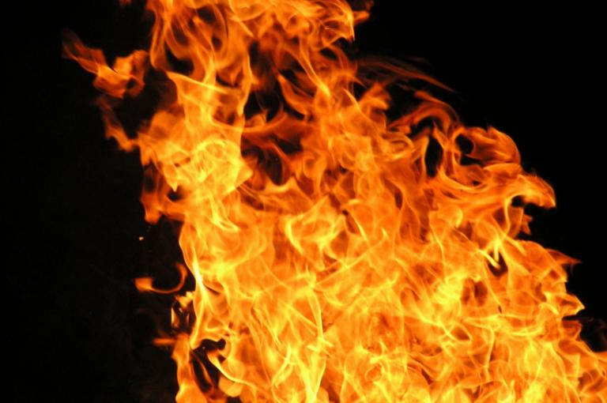
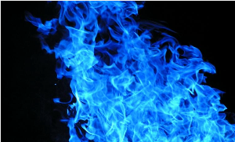
Methodology (cont.)
13
Convert to HSV:
The algorithm first convert the loaded images from RGB (Red-Green-Blue) to HSV (Hue-Saturation-Value) color space.
Then HSV separates color information from intensity, making it suitable for color-based segmentation.
Color Range Definition:
It define the HSV color range that corresponds to fire colors.
The lower and upper bounds of HSV values (e.g., [18, 50, 50] to [35, 255, 255]) that typically represent the colors of fire.
Fig 2: Original input image(RGB)
Fig 3: HSV converted image

Slide 14
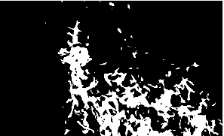
Methodology (cont.)
14
Thresholding and Binary Mask Creation:
After that a threshold is applied to the HSV image based on the defined color range.
Next creating a binary mask where pixels within the thresholded range are set to white (255), indicating potential fire regions, and others are set to black (0).
Fig 4: Binary fire mask

Slide 15


Methodology (cont.)
15
Morphological Operations for Noise Reduction:
Then used morphological operations such as dilation and erosion to refine the binary mask.
Dilation expands the white regions, helping to connect nearby pixels that may belong to the fire region.
Erosion then shrinks the regions, smoothing out irregularities and removing small noise components.
Fig 5: Fire mask after morphological closing
Fig 6: Fire mask after morphological opening

Slide 16
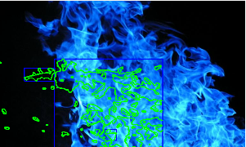
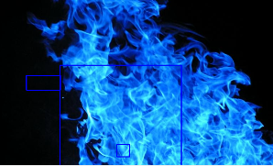
Methodology (cont.)
16
Contour Detection:
Now from the mask identifying contours within the processed binary mask.
Contours are curves joining continuous points along the boundary of white regions, representing potential fire areas.
Bounding Box Calculation:
Finally, computing bounding rectangles around the detected contours.
Bounding rectangles provide a visual representation of the spatial extent of identified fire regions in the original image.
Fig 7: Contour detected image
Fig 8: Fire area detected boxed image

Slide 17
06
Result and Output
17

Slide 18
Result and output
18
Input and output image:
Here after finding the contours, on the basis of contour detection the algorithm decides whether the fire is present or not.
Fig 9: Input image
Fig 10: Contour detected image
Fig 11: Output image(fire detected)

Slide 19



Result and output (cont.)
19
Input and output image:
Here after finding the contours, on the basis of contour detection the algorithm decides whether the fire is present or not.
Fig 12: Input image
Fig 13: Contour detected image (not detected)
Fig 14: Output image(no fire detected)

Slide 20
07
Limitations
20

Slide 21
Limitations
21
Sensitivity to lighting conditions.
Occlusions and obstructions affecting detection.
Limited robustness to image noise.
Dependence on camera quality and resolution.
Designed for static images, not real-time video.
Environmental variability affecting accuracy.
Non-generalized HSV threshold values.
Limited detection range for unusual fires.

Slide 22
08
Conclusion
22

Slide 23
Conclusion
23
The project demonstrates effective fire detection using image processing techniques.
The HSV thresholds and algorithm parameters may need adjustments for different environments and fire types.
The project is a little sensitive to lighting, environmental variables, and computational efficiency are notable limitations.
Integrating the real-time processing and improving robustness to environmental variations can enhance the system.

Slide 24
Thanks!
24
Do you have any questions?
masudurrabby8@gmail.com
+8801840794147

